Slide 1
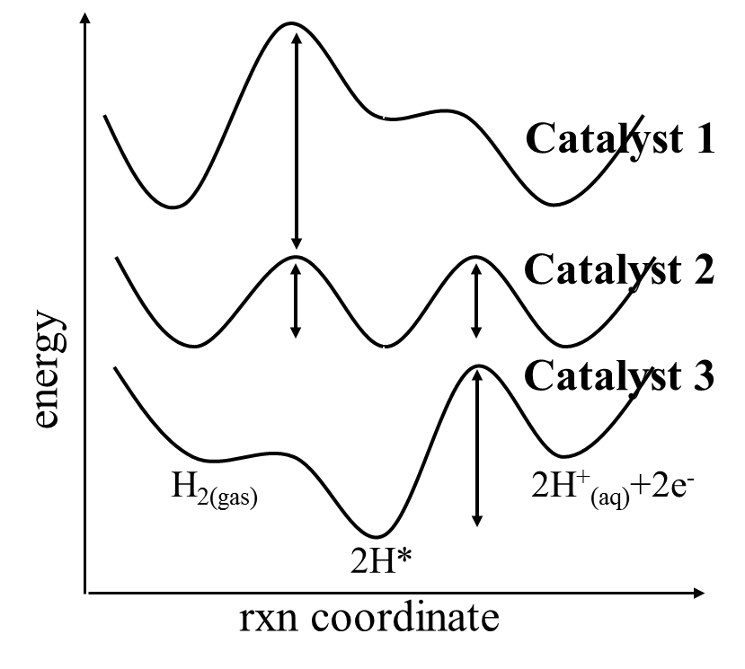
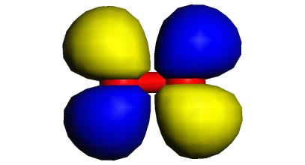
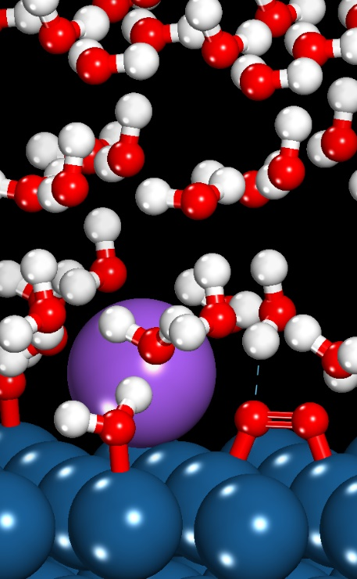
The potential energy surface for catalytic reactions: an overview of computational catalysis
Michael Janik
Department of Chemical Engineering, Pennsylvania State University
^{mjanik@psu.edu}
Mississippi State University
June 15, 2022

Slide 2
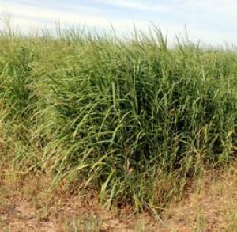
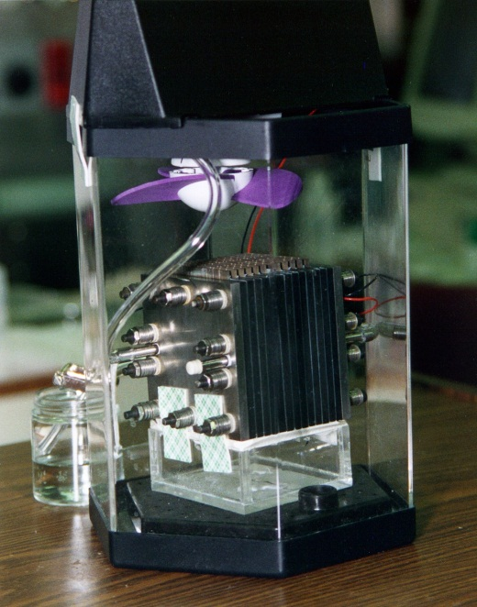
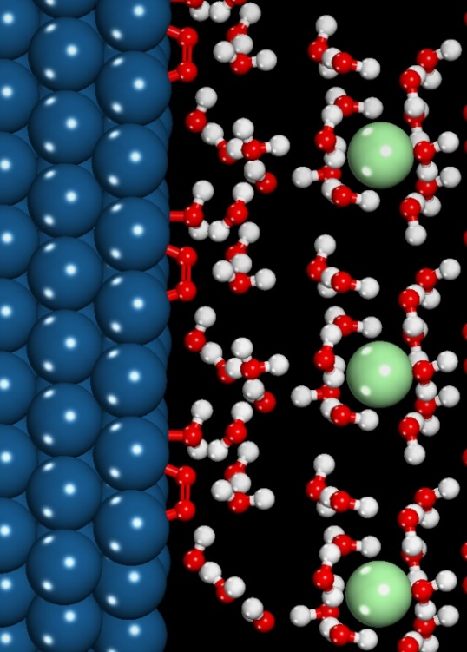
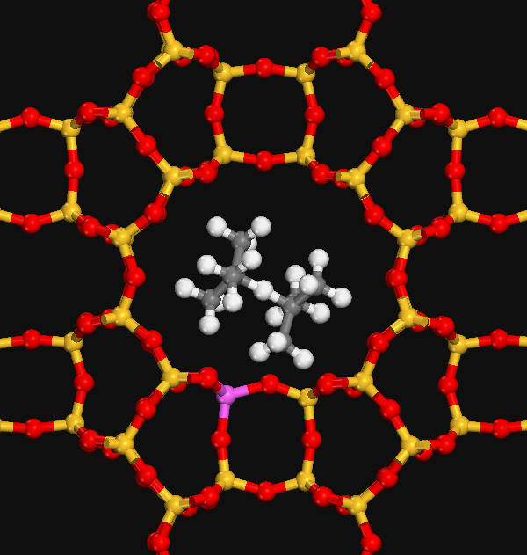
Catalysis plays many roles in our energy future
Enable new energy feedstocks:
-biomass to fuels and chemicals
-renewable electricity to fuels
-solar fuels - photoelectrolysis
Fossil fuel efficiency and diversification
-petroleum use efficiency
-methane to chemicals, liquid fuels
-coal to liquids
Flexible and efficient energy conversion
-Hydrogen production
-Electrocatalysis in fuel cells
-Electrolysis of CO₂ for fuel production
Notes:
2

Slide 3
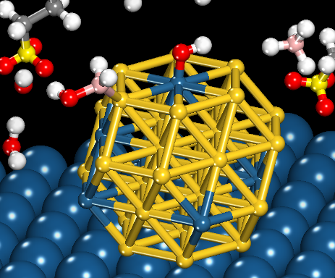
Catalyst activity and selectivity are controlled at the molecular scale:
Structure and morphology
particle size, surface structure, defects, support interactions, stability
Site composition
bimetallics, doped oxide
Surface interactions
coverage effects, intermolecular interactions, poisons, promoters
Reaction environment
temperature, pressure, solution, electric field
Notes:
3

Slide 4
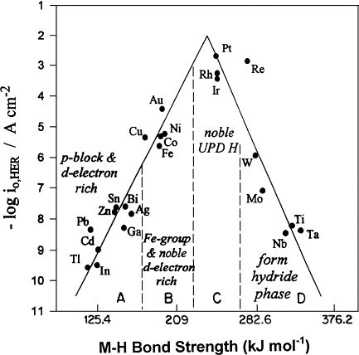
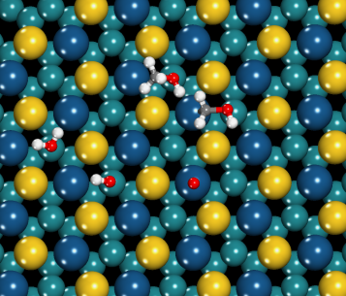
First-principles guided catalyst design
Explain at an atomic level what controls catalyst performance
HER
Catalyst 1
Catalyst 2
energy
Catalyst 3
M-H binding energy (kJ/mol)
H_{2(gas)}
2H⁺_{(aq)}+2e⁻
S. Trasatti. Electrochim. Acta 39 (1994) 1739.
B. E. Conway, G. Jerkiewicz. Solid State Ionics 152 (2002) 93.
H_{2, gas} → 2H*
2H* → 2H⁺ + 2e⁻
2H*
rxn coordinate
Catalyst Design Procedure:
Detailed studies on reaction steps, path, environment effects
Identify key parameters (energetics) that dictate performance
Evaluate parameters over a design space for improved performance
H_{2, gas}→ 2H⁺ + 2e⁻
Virtual lab: “computational experiments”
to design new catalytic materials

Slide 5
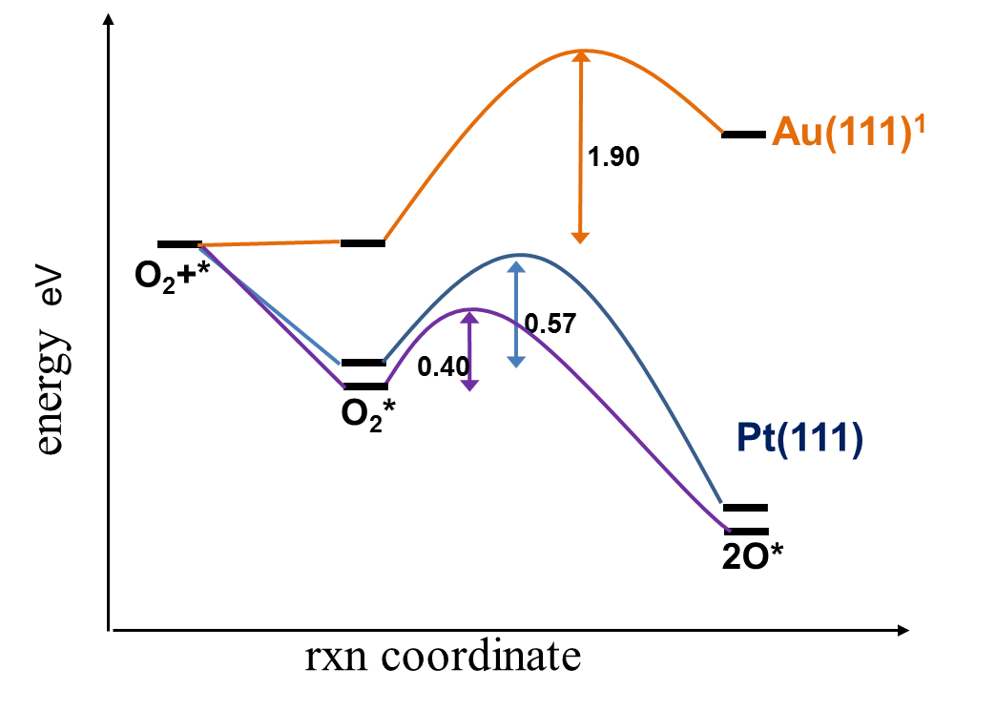
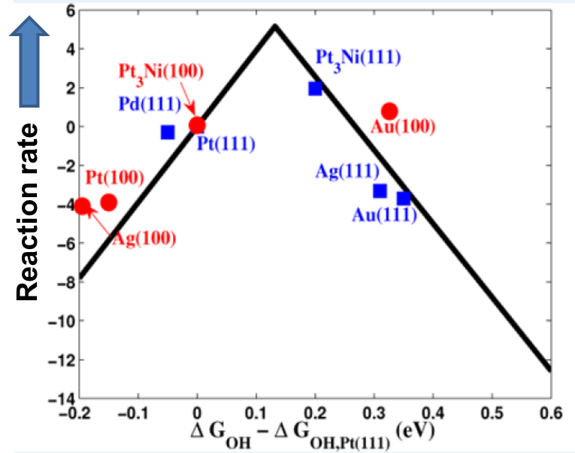
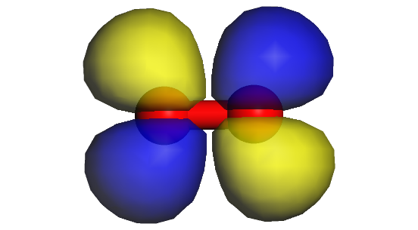
Oxidation catalysis by metals: DFT for O₂ activation
O₂ molecular orbitals
Oxidation “volcano” curves
O₂ binding to metals and activation
Notes:
Add photos, revise text

Slide 6
Oxidation using molecular oxygen on metals
How does a metal catalyst activate O₂ to participate in oxidation reactions?
What is the key energetic parameter to dictate activity to reduce O₂?
DFT calculation to first examine the electronic structure of O₂
1) Build O₂
2) Set-up geometry optimization calculation
3) DFT – solve for wavefunctions (orbitals), energy, minimum energy structure
4) Analyze results

Slide 7
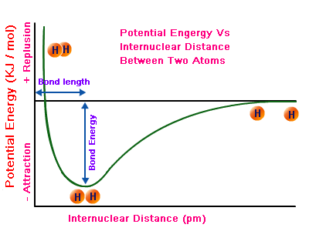
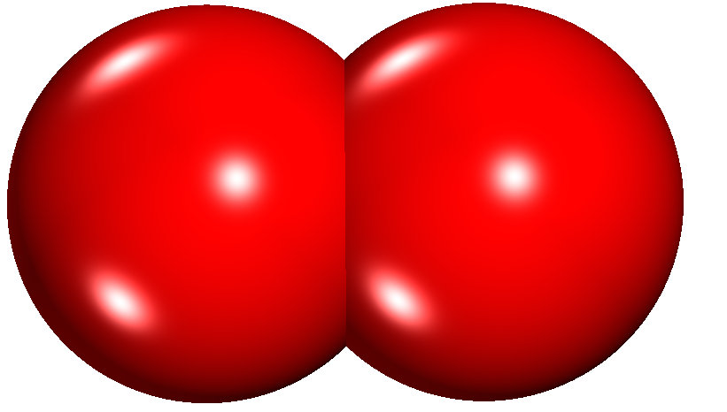
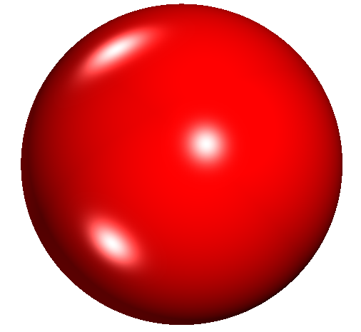
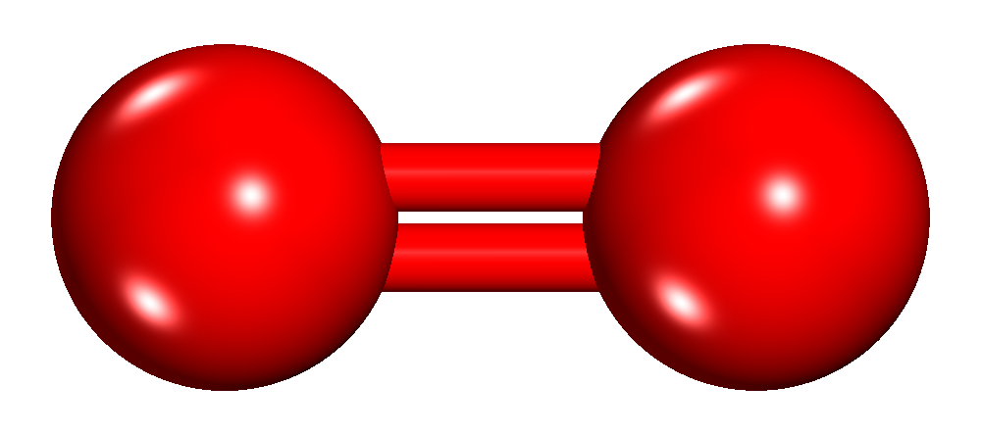
Geometry optimization of O₂

Slide 8
Geometry optimization of O₂
dE/dx
1)Guess a distance: initial structure
2) DFT – get ψ’s, E, dE/dx
Move to new distance
Repeat until dE/dx ~ 0
Gives optimal structure and final E, ψ’s

Slide 9
Geometry optimization of O₂
O VASP energy = -1.84 eV
O₂ VASP energy = -9.823 eV
Bond energy = E(O₂)-2E(O)
= -6.15 eV = -593 kJ/mol
Optimal bond distance 1.23 Å

Slide 10
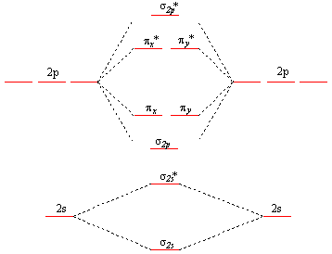
Molecular orbital diagram of O₂
σ_{2p}*
π_{x}*
π_{y}*
2p
2p
O
π_{x}
O
π_{y}
σ_{2p}
σ_{2s}*
2s
O₂
2s
σ_{2s}
O—O bond distance 1.23 Å
O₂ energy from VASP -9.82 eV Bond energy
O energy from VASP -1.84 eV E(O₂)-2E(O) = -6.15 eV = -593 kJ/mol

Slide 11

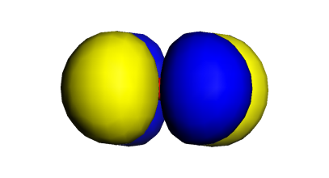
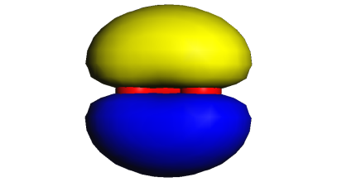
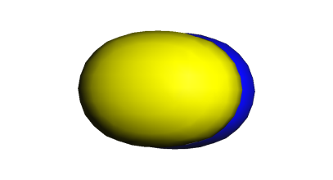
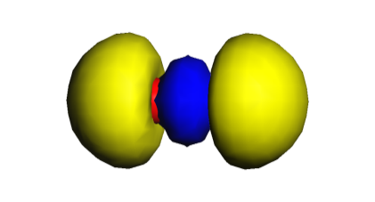
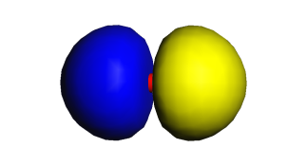
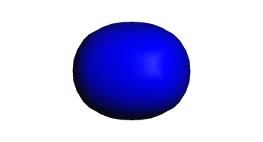
Molecular orbital diagram of O₂
σ_{2p}*
π_{x}*
π_{y}*
2p
2p
O
π_{x}
O
π_{y}
σ_{2p}
σ_{2s}*
2s
O₂
2s
σ_{2s}
O—O bond distance 1.23 Å
O₂ energy from VASP -9.82 eV Bond energy
O energy from VASP -1.84 eV E(O₂)-2E(O) = -6.15 eV = -593 kJ/mol

Slide 12
Molecular orbital diagram of O₂
↑
↑
2p
2p
O
↑↓
↑↓
O
↑↓
↑↓
2s
O₂
2s
↑↓
Ground state (lowest energy electron occupation of orbitals) is a triplet
2 unpaired electrons in π* orbitals.

Slide 13
Now I want to put O₂ on a surface and calculate the energy change to adsorb it.
What DFT calculations do I need to run?
?
Notes:
Might mention here – the d_{xz} will have different energy, size, etc on different metals, bind O₂ at different strengths, be better or worse at activating O₂. Also, could mention Na promotion of O2 dissociation

Slide 14
Now I want to put O₂ on a surface and calculate the energy change to adsorb it.
What DFT calculations do I need to run?
O2(gas) + surface → O2 on the surface
ΔE_{ads} = E_{O2 on surface} – E_{O2 in gas phase} – E_{surface with nothing on it}
DFT calculations
O2 gas
Surface (*)
O2 on surface (O2*)
O2 + * → O2*
Notes:
Might mention here – the d_{xz} will have different energy, size, etc on different metals, bind O₂ at different strengths, be better or worse at activating O₂. Also, could mention Na promotion of O2 dissociation

Slide 15
Woody will show you how to build (cut) a surface later today, and how to put an adsorbate on that surface.
Let’s take a look at O2 on a surface.
Choices – how many layers?
What is frozen?
What is my supercell size (I am showing you a 3x3 surface cell – 9 Pt atoms per layer). Surface cell size dictates “fractional coverage”
Notes:
Might mention here – the d_{xz} will have different energy, size, etc on different metals, bind O₂ at different strengths, be better or worse at activating O₂. Also, could mention Na promotion of O2 dissociation

Slide 16
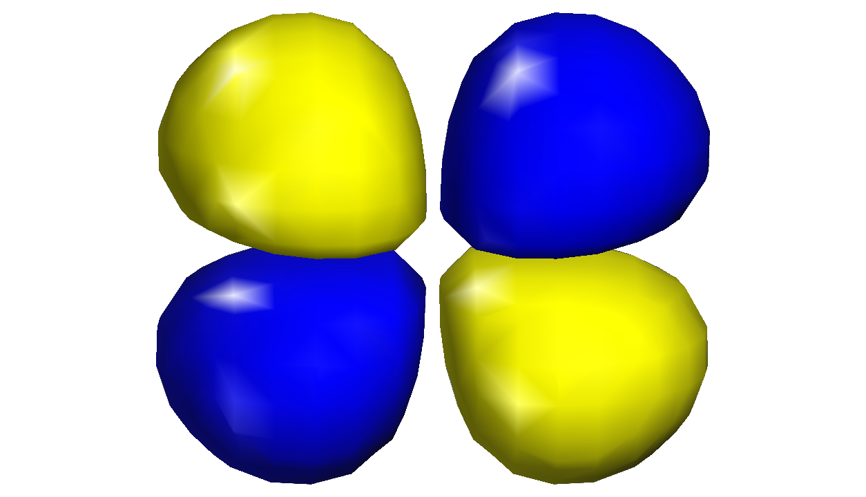
O₂ on metal surface – bonding is between O₂ π* orbital and metal d orbitals
↑
↑
O₂ π*
↑↓
M d_{xz}
O₂ π*
O
O
O₂ π* and M d_{xz} form a bonding orbital
Occupation lowers energy – O₂ has an exothermic adsorption
E(O₂) = -9.823 eV
E(Pt(111)) = -315.201 eV
E(O₂ on Pt(111)) = -325.624 eV
Adsorption energy = -0.60 eV = 58 kJ/mol
M d_{xz}
M
Donation of e⁻ from M d_{xz} to O₂ π* orbital weakens O—O bond, lowering bond dissociation barrier
(O—O gas 1.23 Å, O—O on Pt(111) 1.37 Å)
Notes:
Might mention here – the d_{xz} will have different energy, size, etc on different metals, bind O₂ at different strengths, be better or worse at activating O₂. Also, could mention Na promotion of O2 dissociation

Slide 17
Potential energy surface of O₂ activation on metals
No catalyst, E_{act} = 6.15 eV
Au(111)¹
Catalyst 1
1.90
δ+
δ-
eV
O₂+*
Catalyst 2
Na
O—O
0.57
energy
0.40
Catalyst 3
e⁻
O₂*
Pt(111)
H_{2(gas)}
2H⁺_{(aq)}+2e⁻
2O*
2H*
rxn coordinate
We can connect the O₂ dissociation barrier and resultant rate to the extent of electron donation to the O₂ π* orbital
1) Au(111) data from Fajin et al. Applied Catalysis A: General 458 (2013) 90
Notes:
PES should have gas phase barrier, Pt(111) barrier, Pt-Na-111 barrier.

Slide 18
What DFT calculations did I have to run to map out the “potential energy” surface on the last slide?
?
Notes:
Might mention here – the d_{xz} will have different energy, size, etc on different metals, bind O₂ at different strengths, be better or worse at activating O₂. Also, could mention Na promotion of O2 dissociation

Slide 19
What DFT calculations did I have to run to map out the “potential energy” surface on the last slide?
O2 gas phase
*
O2*
2O* (ie, the product state for O2 molecule dissociating)
A transition state search for the highest energy state as the O-O bond stretched to become 2 O
Notes:
Might mention here – the d_{xz} will have different energy, size, etc on different metals, bind O₂ at different strengths, be better or worse at activating O₂. Also, could mention Na promotion of O2 dissociation

Slide 20
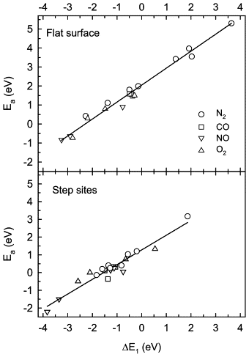
Faster O₂ activation correlates with stronger O binding
If O₂ activates easier (more quickly) than O binds more strongly.
Note same pattern for other diatomics (N₂, CO, NO)
Dissociation activation barrier
Product adsorption strength
1) Figure from Bligaard et al., J. Catal. 224 (2004) 206
Notes:
PES should have gas phase barrier, Pt(111) barrier, Pt-Na-111 barrier.

Slide 21
Sabatier’s principle: optimal rate occurs with medium binding reaction intermediate
Oxygen reduction reaction (proton oxidation reaction)
O₂ + H₂ → O or OH intermediates → H₂O
Optimal catalyst has an intermediate binding energy for oxygen
Pt(ML) on M(111)
Pt/Pd(111)
Pt (111)
Reaction rate
Left figure from Bligaard et al., J. Catal. 224 (2004) 206; right figure from Zhang et al., Angew Chemie 44 (2005) 2132

Slide 22
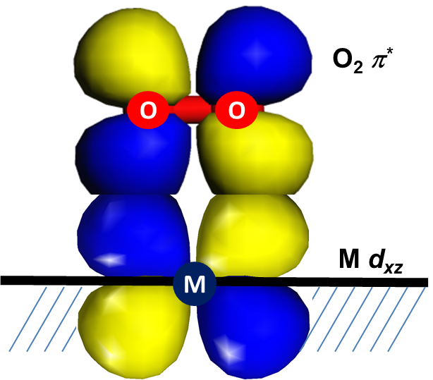
DFT can give us remarkably detailed and accurate insight
Electronic structure nature of
O₂ π* - Metal d interaction
Elementary reaction energetics
(activation barriers)
Correlations across reaction steps
in a mechanism
Catalyst material optimization
Notes:
PES should have gas phase barrier, Pt(111) barrier, Pt-Na-111 barrier.

Slide 23
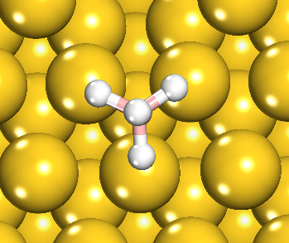
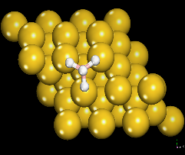
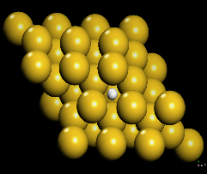
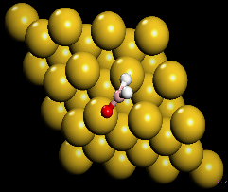
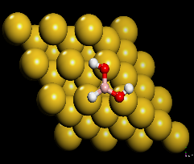
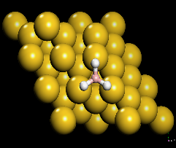
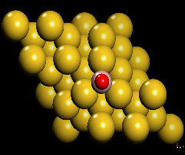
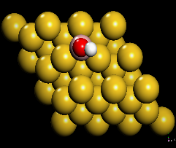
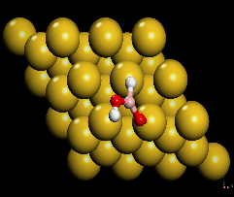
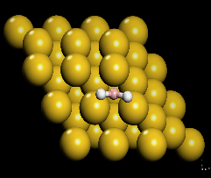
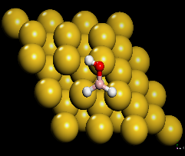
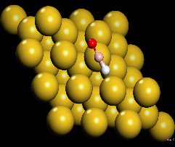
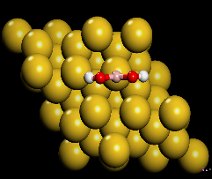
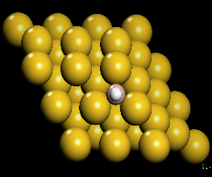
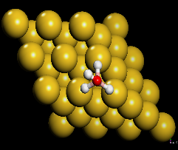
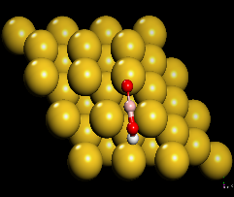
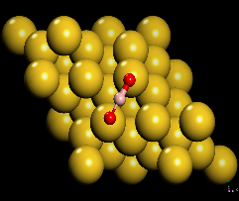
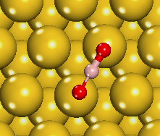

Reaction Intermediates and Adsorption Sites
BH₄* (+8OH⁻)
BH₄*
H*
BH₂O*
BH(OH)₂*
BH₃*
BO*
BOH*
BHOOH*
BH₂*
BH₂OH*
BHO*
B(OH)₂*
BH*
BH₃OH*
BOOH*
BO₂*
BO₂*
(+6H₂O+8e⁻)
Assumption – all adsorbates can access there most stable configuration

Slide 24
Minimum Energy Path over Au(111)
1.0
BO₂*
BH₄*
BH₃*
BH₄⁻ (aq)
BH₂*
0.0
BH₄*
BH₂OH *
BHOH*
BOOH*
BH(OH)₂*
B(OH)₂*
-1.0
BH₃*
U= -1.0 V (NHE)
BH₂*
-2.0
-3.0
Relative energy (eV)
BH₂OH*
U= -0.2 V (NHE)
-4.0
BHOH*
-5.0
BH(OH)₂*
-6.0
B(OH)₂*
BOOH*
BO₂*
-7.0
Borohydride oxidation

